Slide 1
Object Oriented Programming using Java (ECSE102L)

Slide 2
Outline
Finding output of loop
Finding output of nested loop

Slide 3
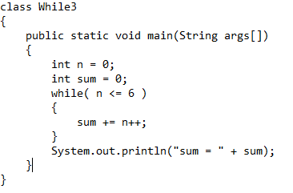
Finding Output of Loop
S

Slide 4
Finding Output of Loop (Cont…)
S
Output:
21

Slide 5
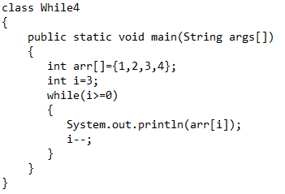
Finding Output of Loop
S

Slide 6
Finding Output of Loop (Cont…)
S
Output:
4
3
2
1

Slide 7
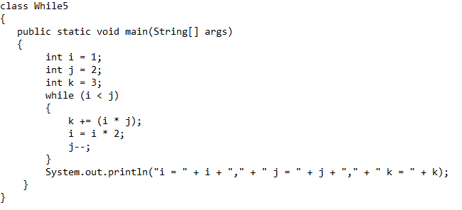
Finding Output of Loop
S

Slide 8
Finding Output of Loop (Cont…)
S
Output:
i = 2, j = 1, k = 5

Slide 9
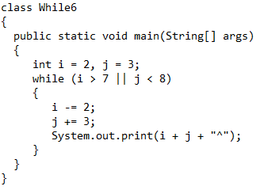
Finding Output of Loop
S

Slide 10
Finding Output of Loop (Cont…)
S
Output:
6^7^

Slide 11
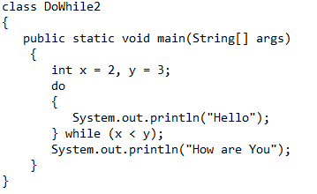
Finding Output of Loop
S

Slide 12
Finding Output of Loop (Cont…)
S
Output:
Hello
Hello
Hello
.
.
.
.

Slide 13
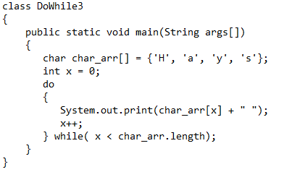
Finding Output of Loop
S

Slide 14
Finding Output of Loop (Cont…)
S
Output:
H a y s

Slide 15
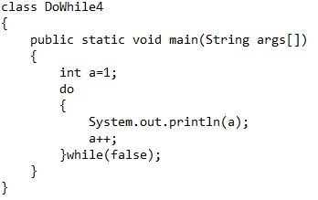
Finding Output of Loop
S

Slide 16
Finding Output of Loop (Cont…)
S
Output:
1

Slide 17
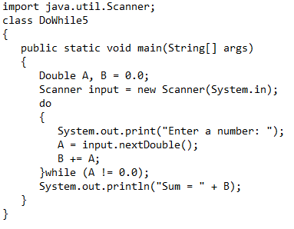
Finding Output of Loop
S

Slide 18
Finding Output of Loop (Cont…)
S
Output:
Enter a number: //user will give number
Enter a number: //user will give number
Enter a number: //user will give number
When user will enter 0, sum will be calculated.

Slide 19
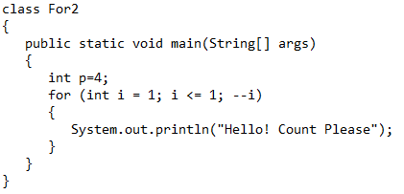
Finding Output of Loop
S

Slide 20
Finding Output of Loop (Cont…)
S
Output:
Hello! Count Please
Hello! Count Please
Hello! Count Please
Hello! Count Please
.
.
.

Slide 21
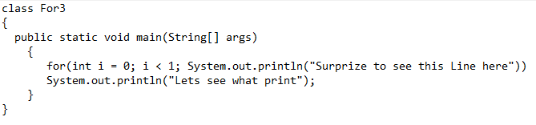
Finding Output of Loop
S

Slide 22
Finding Output of Loop (Cont…)
S
Output:
Lets see what print
Surprize to see this Line here
Lets see what print
Surprize to see this Line here
Lets see what print
Surprize to see this Line here
.
.
.

Slide 23
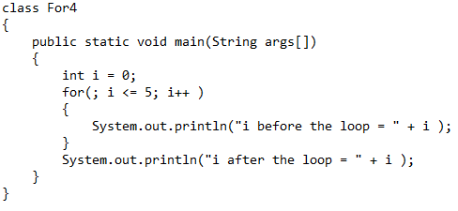
Finding Output of Loop
S

Slide 24
Finding Output of Loop (Cont…)
S
Output:
i before the loop = 0
i before the loop = 1
i before the loop = 2
i before the loop = 3
i before the loop = 4
i before the loop = 5
i after the loop = 6

Slide 25
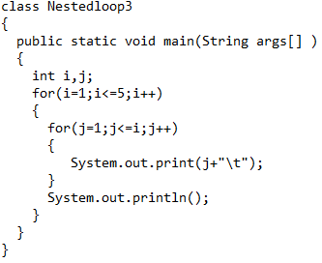
Finding Output of Loop
S

Slide 26
Finding Output of Loop (Cont…)
S
Output:
    1
1 2
1 2 3
1 2 3 4
1 2 3 4 5

Slide 27
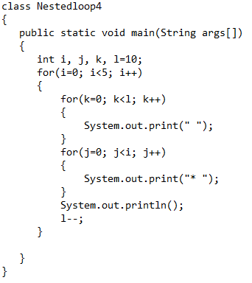
Finding Output of Loop
S

Slide 28
Finding Output of Loop (Cont…)
S
Output:
    * //Some space will be there. Then, * will be printed
    * *
    * * *
    * * * *

Slide 29
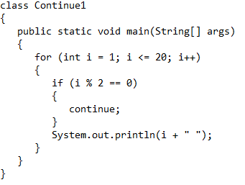
Finding Output of Loop
S

Slide 30
Finding Output of Loop (Cont…)
S
Output:
    1
    3
    5
    7
    9
    11
    13
    15
    17
    19

Slide 31
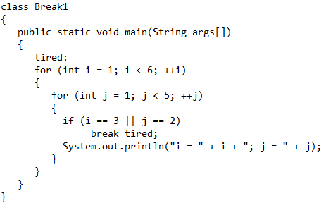
Finding Output of Loop
S

Slide 32
Finding Output of Loop (Cont…)
S
Output:
    i = 1; j = 1

Slide 33




